Slide 1
Waterfalls and Headward Erosion

Slide 2
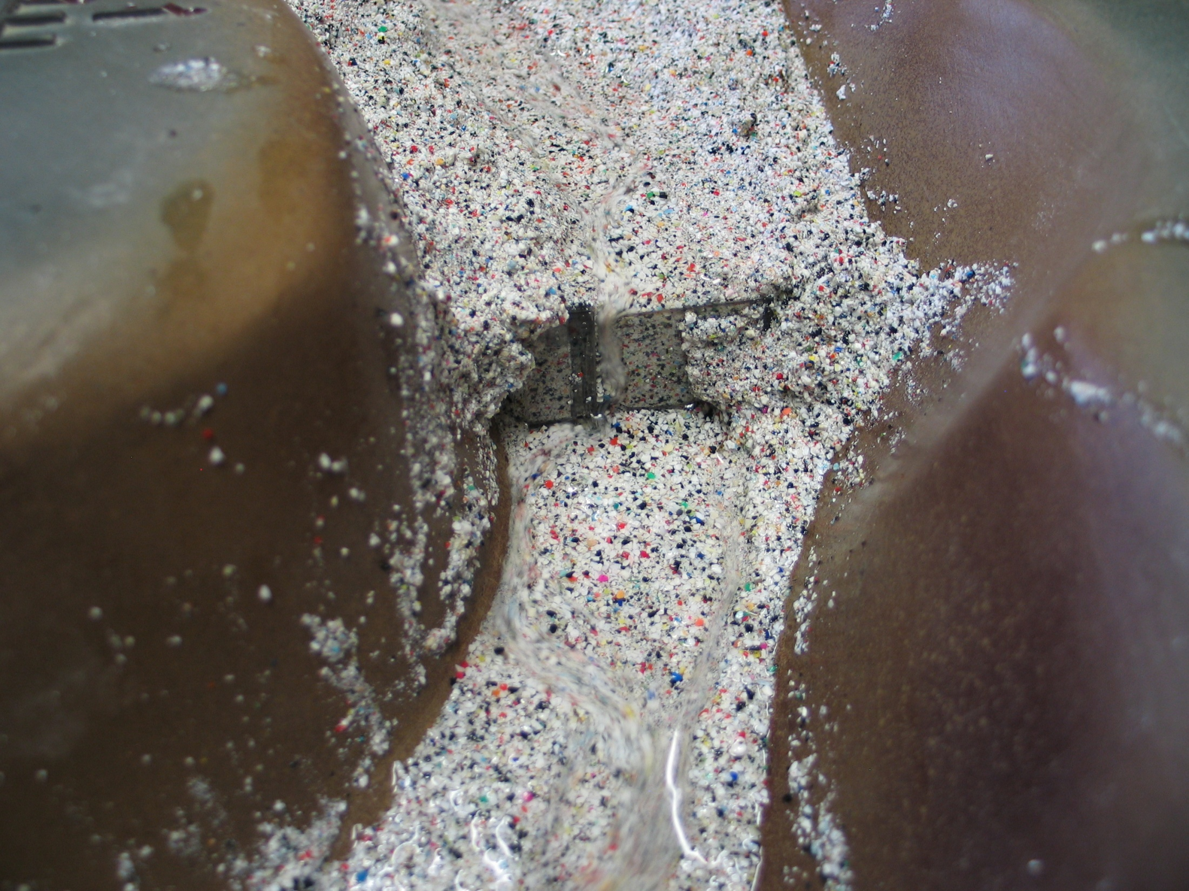
Slide 2

Slide 3
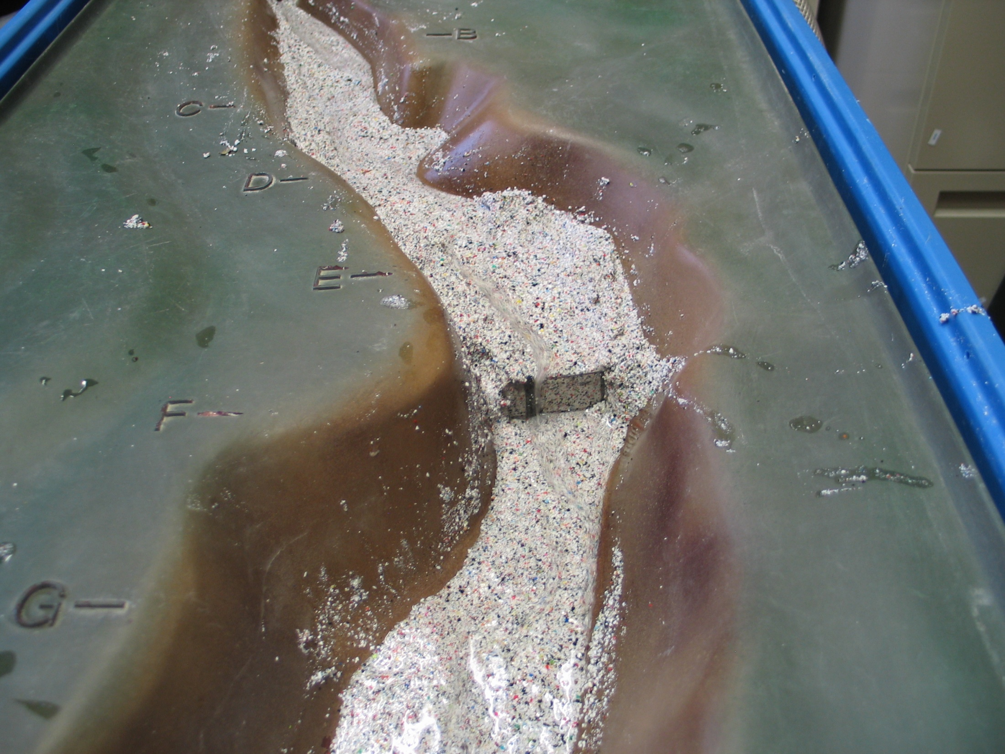
Slide 3
Waterfalls Erode Down into the Bedrock and Erode Upstream to Form Gorges

Slide 4
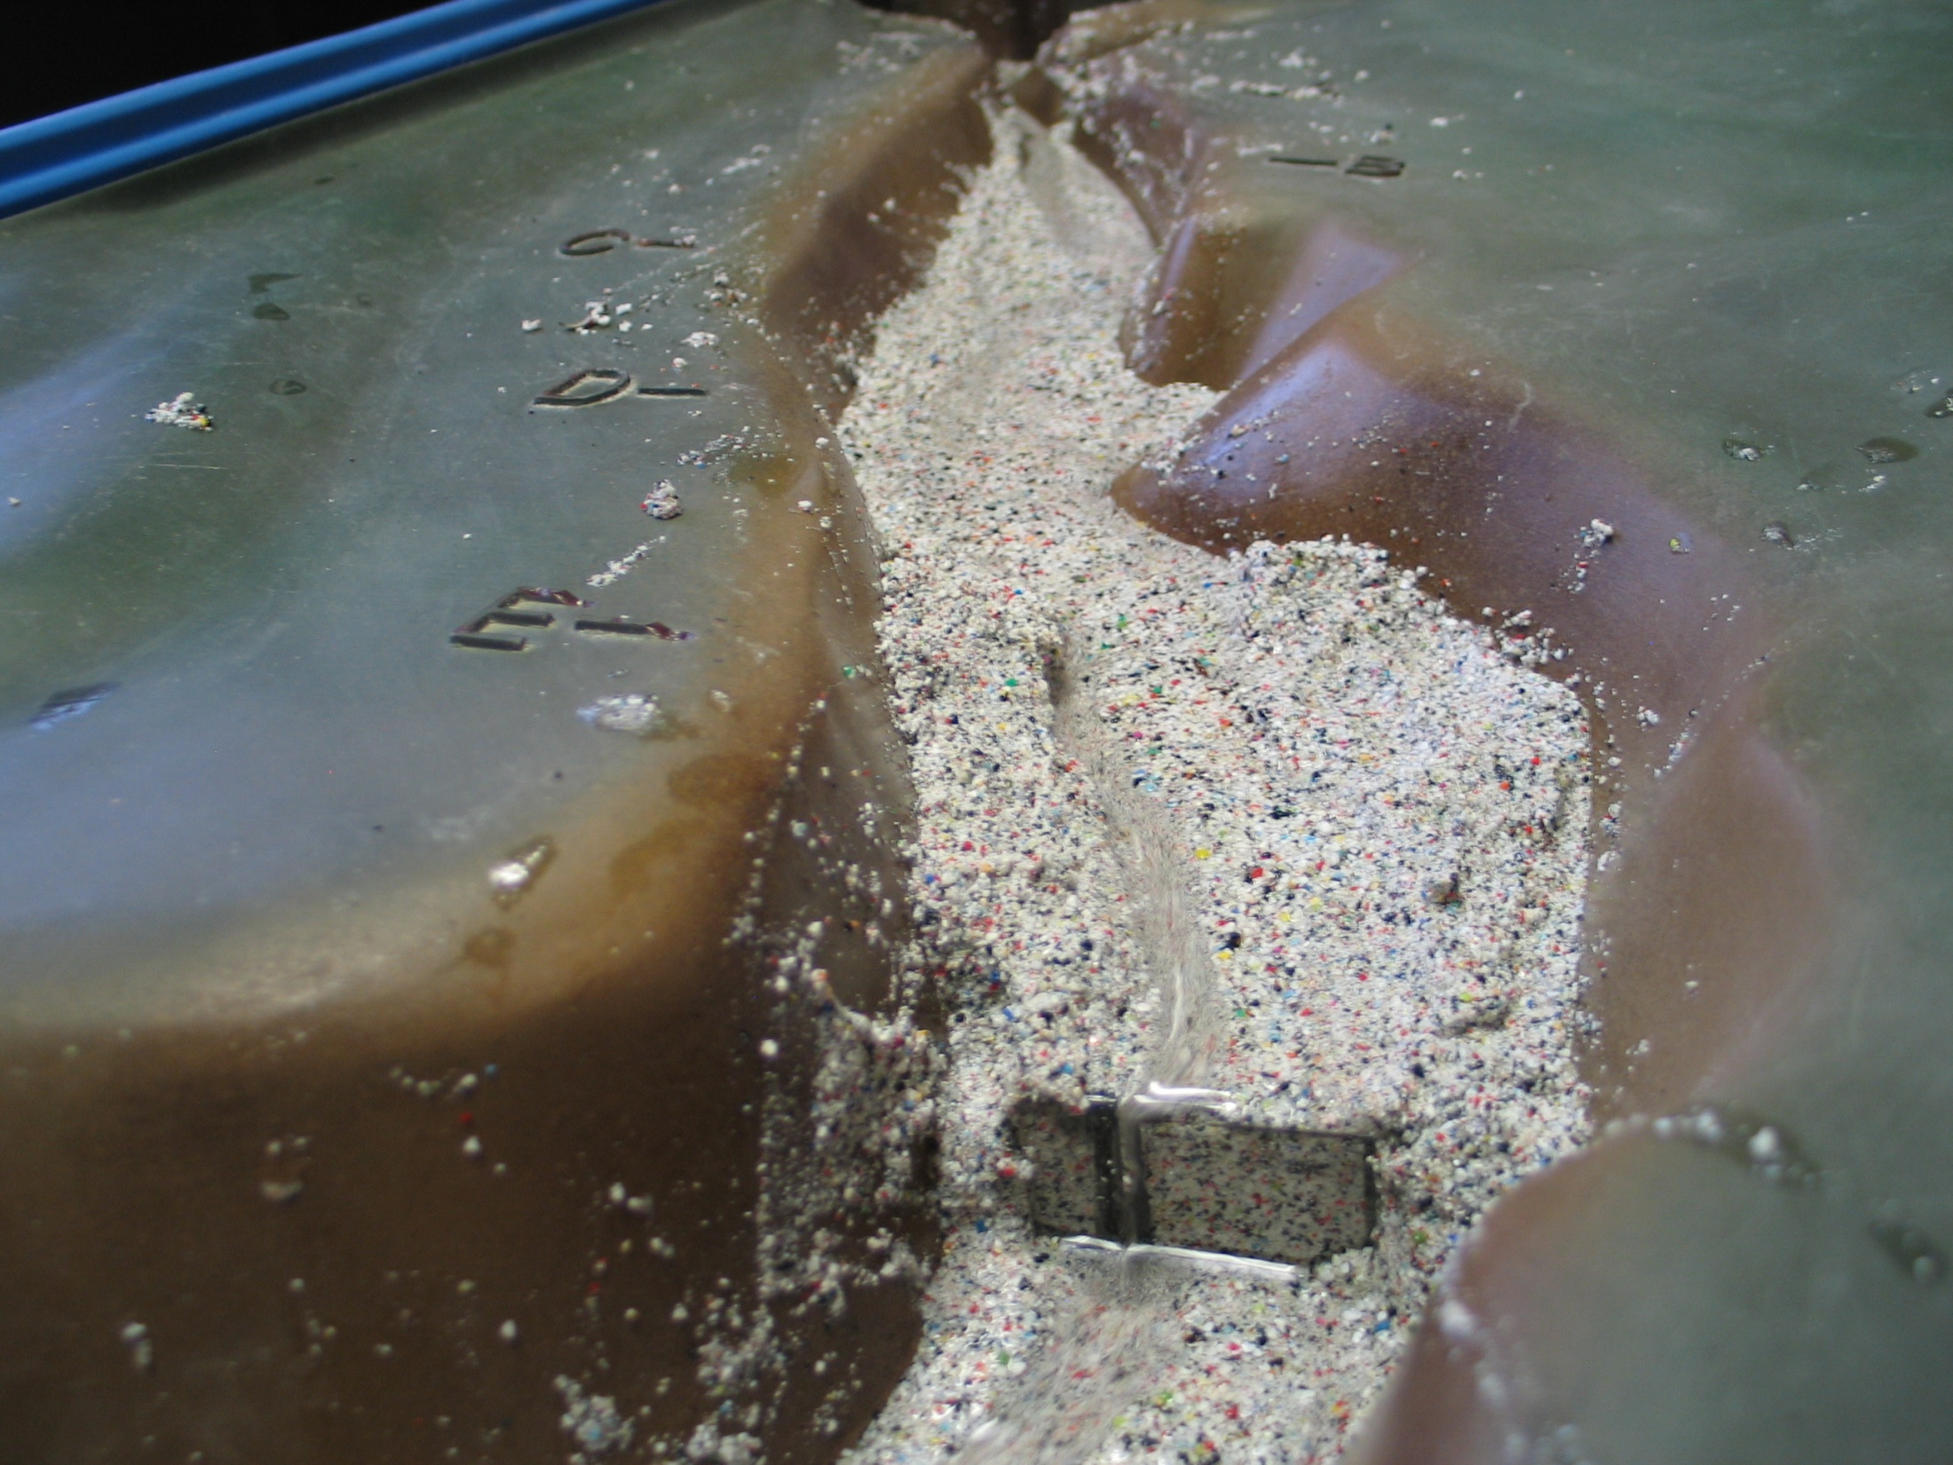
Slide 4
A Waterfall Creates a Plunge Pool Below It

Slide 5
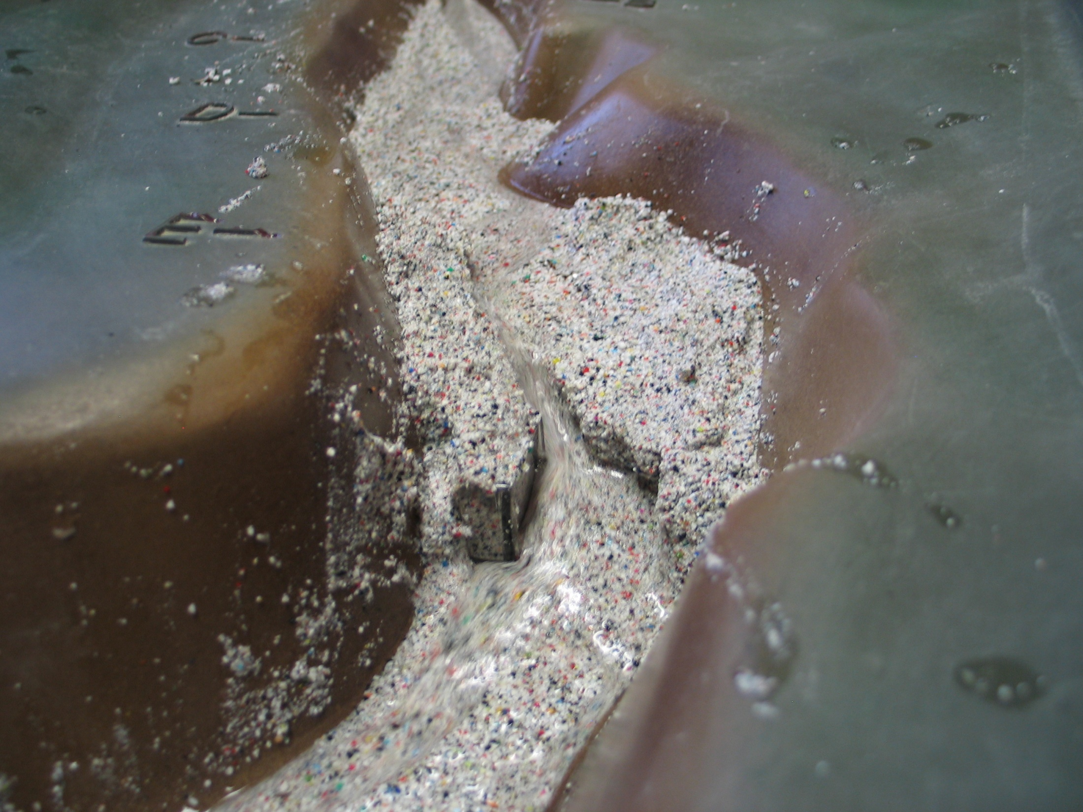
Slide 5
This Waterfall Eroded into a Weaker Bedrock Layer
Allowing It to Erode a Gorge Headward

Slide 6
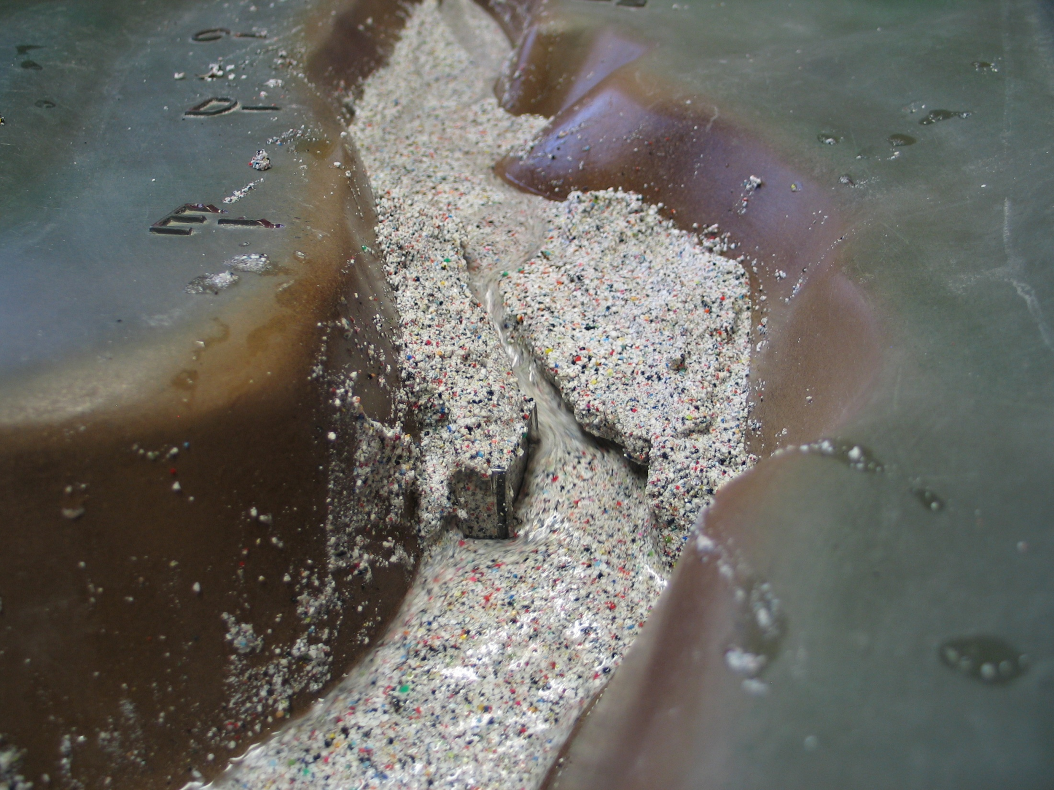
Slide 6
Notice the Headward Erosion
The Gorge Cuts Deeper and Moves Further Upstream

Slide 7
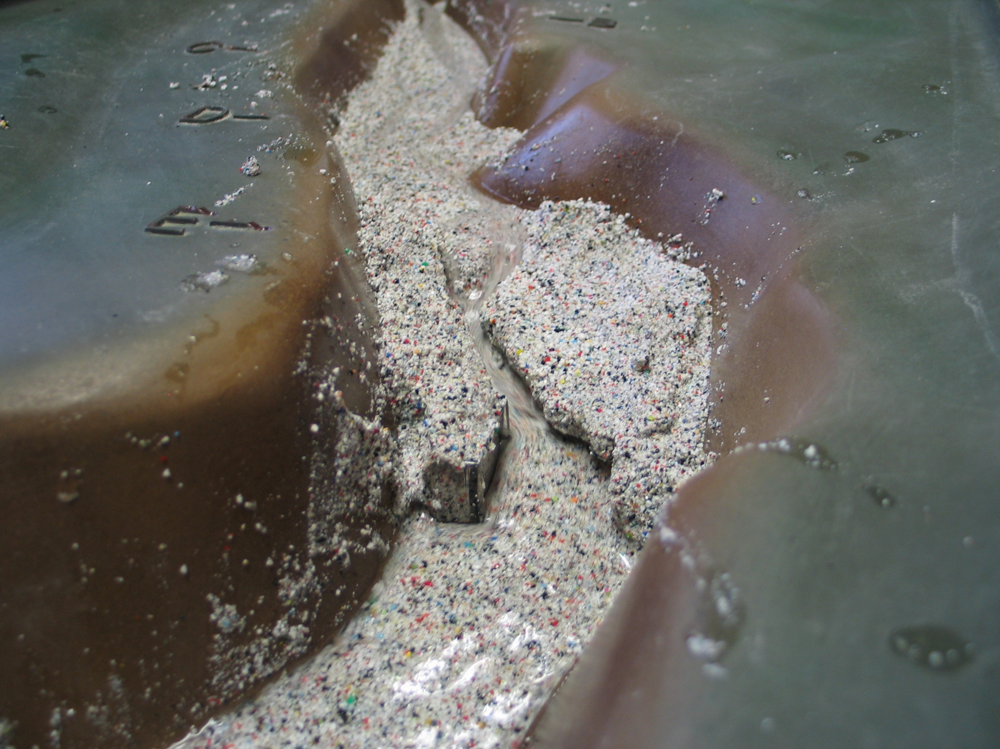
Slide 7

Slide 8
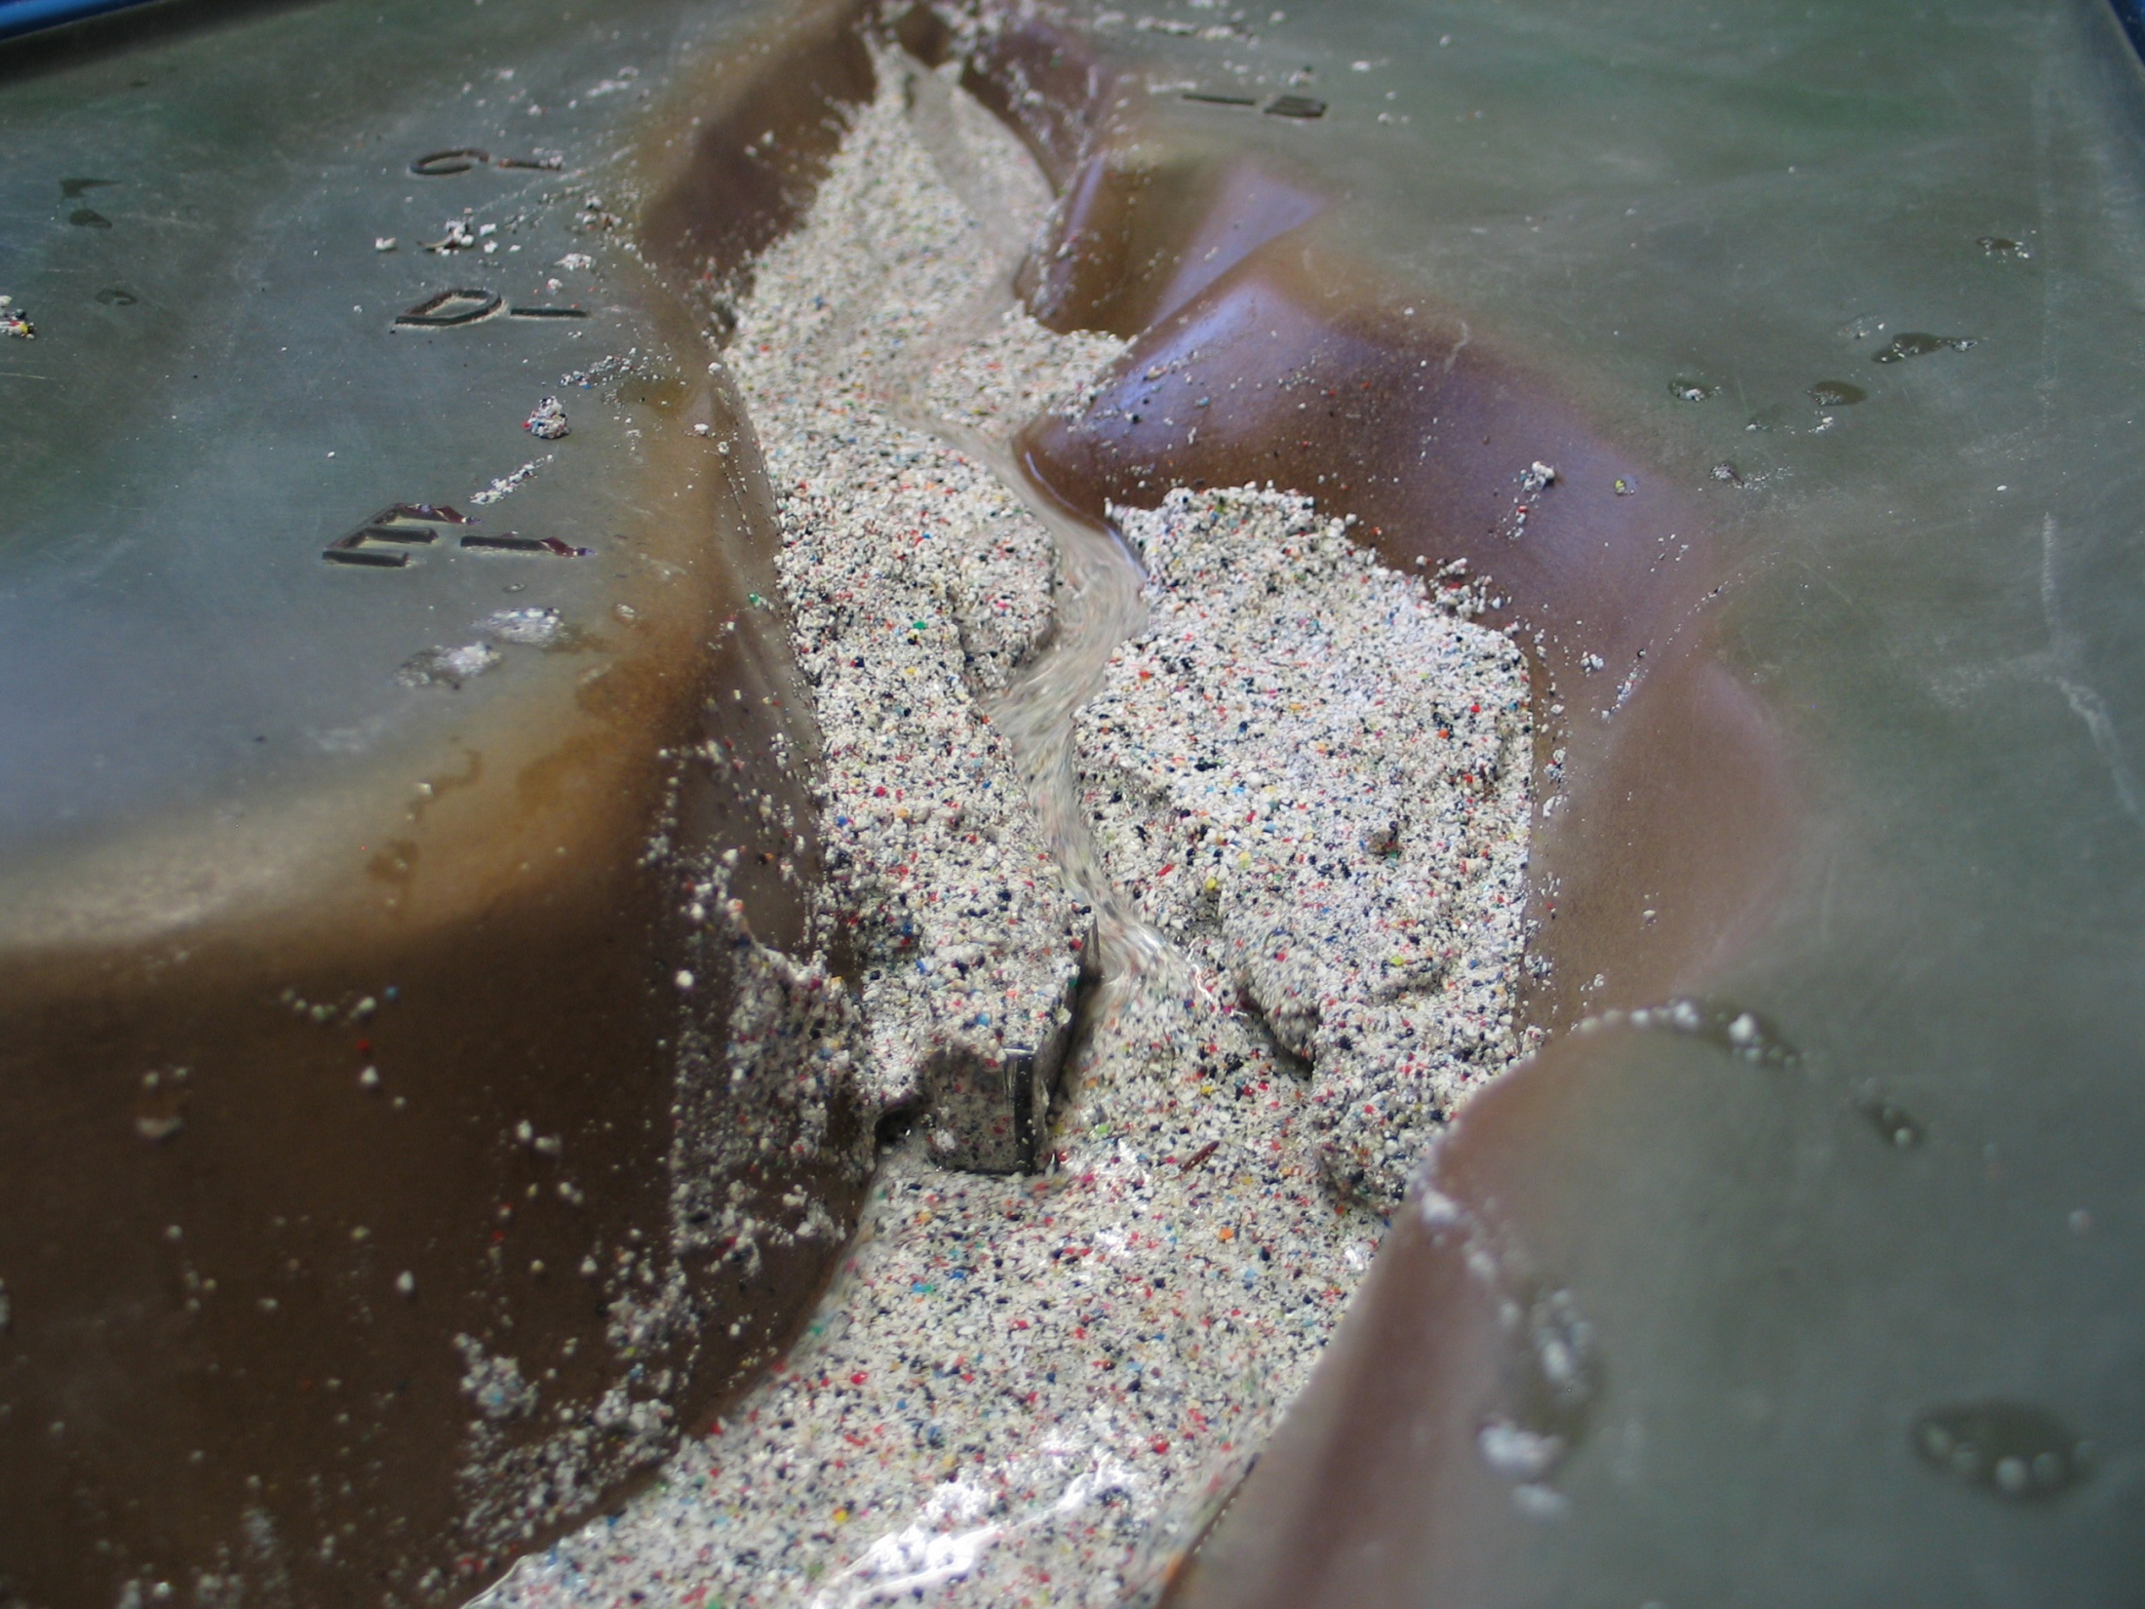
Slide 8

Slide 9
End Slide
This project was made possible in part by a grant from
Washington’s National Park Fund.

